Slide 1
Lecture

Slide 2
Standard Forms
Certain types of Boolean expressions lead to gating networks which are desirable from implementation viewpoint.
Two Standard Forms: Sum-of-Products and Product-of-Sums
Literals: a variable on its own or in its complemented form. Examples: x, x' , y, y'
Product Term: a single literal or a logical product (AND) of several literals.
Examples: x, x.y.z', A'.B, A.B

Slide 3
Sum Term: a single literal or a logical sum (OR) of several literals.
Examples: x, x+y+z', A'+B, A+B
Sum-of-Products (SOP) Expression: a product term or a logical sum (OR) of several product terms.
Examples: x, x+y.z', x.y'+x’.y.z, A.B+A'.B'
Product-of-Sums (POS) Expression: a sum term or a logical product (AND) of several sum terms.
Examples: x, x.(y+z'), (x+y').(x'+y+z), (A+B).(A'+B')

Slide 4
Every Boolean expression can either be expressed as sum-of-products or product-of-sums expression.
Examples:
SOP: x′.y + x.y′ + x.y.z
POS: (x + y′).(x′ + y).(x′ + z′)
both: x′ + y + z or x.y.z′
neither: x.(w′ + y.z) or z′ + w.x′.y + v.(x.z + w′)

Slide 5
Minterm & Maxterm
Consider two binary variables x, y.
Each variable may appear as itself or in complemented form as literals (i.e. x, x' & y, y' )
For two variables, there are four possible combinations with the AND operator, namely:
x'.y', x'.y, x.y', x.y
These product terms are called the minterms.
A minterm of n variables is the product of n literals from the different variables (One literal from each variable).

Slide 6
Minterm & Maxterm
In general, n variables can give 2^{n} minterms.
In a similar fashion, a maxterm of n variables is the sum of n literals from the different variables.
Examples: x'+y', x'+y, x+y',x+y
In general, n variables can give 2^{n} maxterms.

Slide 7
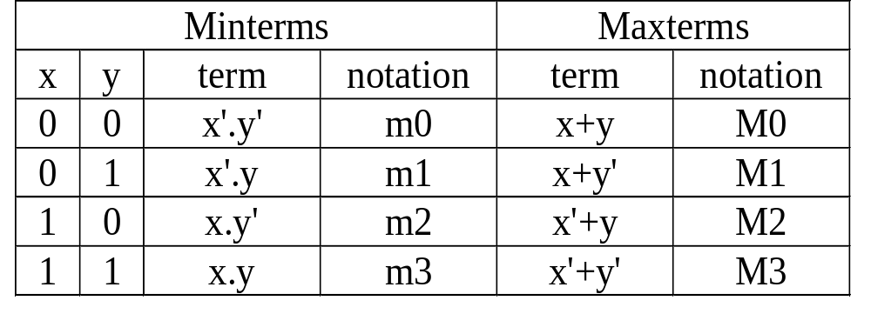
Minterm & Maxterm
The minterms and maxterms of 2 variables are denoted by m0 to m3 and M0 to M3 respectively:
Each: Minterm is the complement of the corresponding maxterm:
Example: m₂ = x.y'
m₂' = (x.y')' = x' + (y')' = x'+y = M2

Slide 8
Canonical Form: Sum of Minterms
What is a canonical/normal form?
  A unique form for representation.
Minterms are product terms.
  Can express Boolean functions using Sum-of-Minterms form.

Slide 9
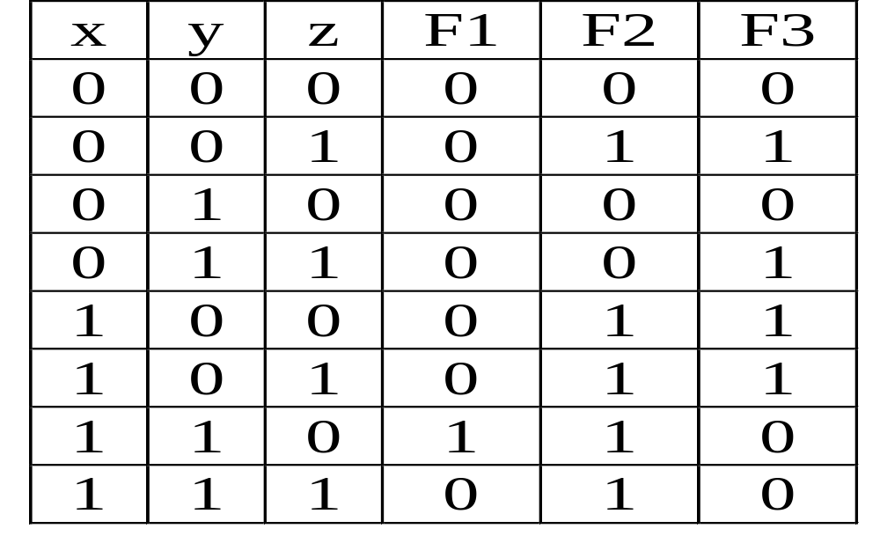
Canonical Form: Sum of Minterms
a) Obtain the truth table. Example:

Slide 10
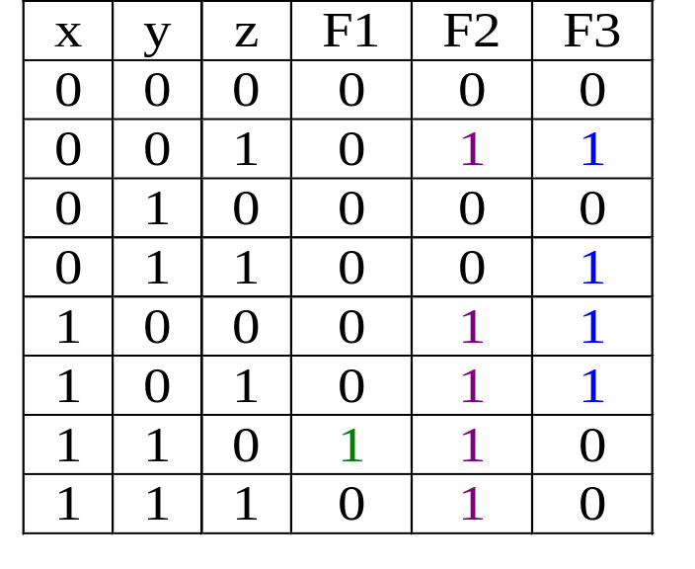
Canonical Form: Sum of Minterms
Obtain Sum-of-Minterms by gathering/summing the minterms of the function (where result is a 1)
F1 = x.y.z' = Σm(6)
F2 = x'.y'.z + x.y'.z‘ + x.y'.z + x.y.z‘ + x.y.z
= Σm(1,4,5,6,7)
F3 = x'.y'.z + x'.y.z
+ x.y'.z' +x.y'.z
= Σm(1,3,4,5)

Slide 11
Canonical Form: Product of Maxterms
Maxterms are sum terms.
For Boolean functions, the maxterms of a function are the terms for which the result is 0.
Boolean functions can be expressed as Products-of-Maxterms.

Slide 12
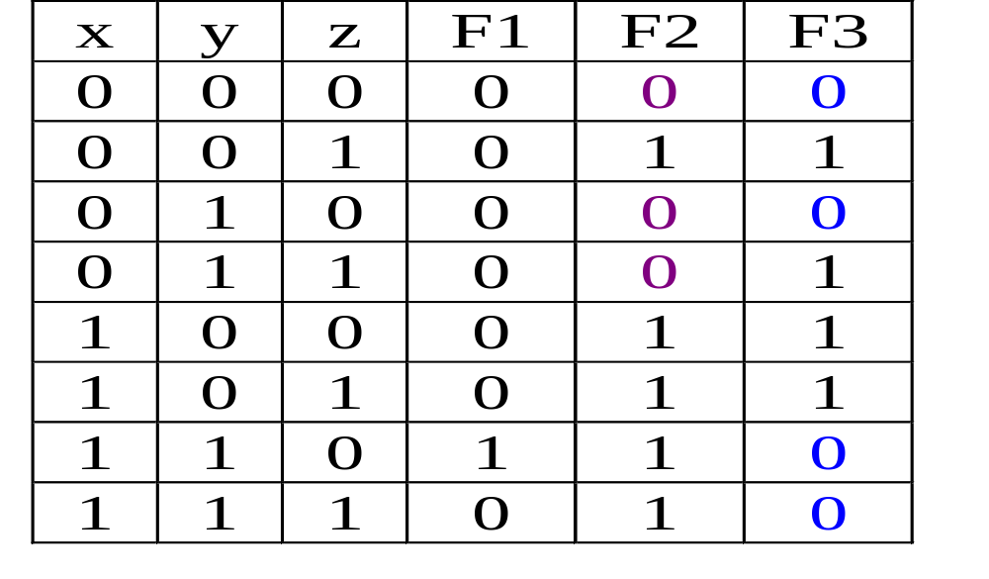
Canonical Form: Product of Maxterms
E.g.: F2 = ΠM(0,2,3) = (x+y+z).(x+y'+z).(x+y'+z')
F3 = ΠM(0,2,6,7)
= (x+y+z).(x+y'+z).(x'+y'+z).(x'+y'+z')

Slide 13
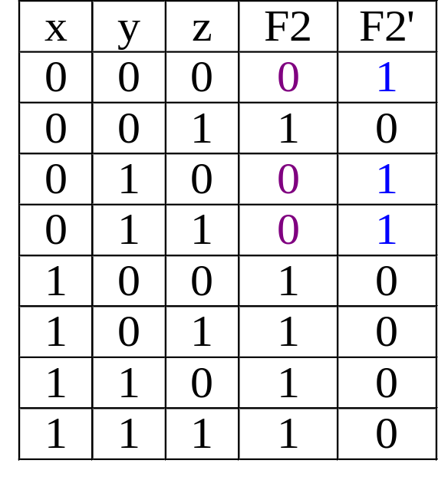
Canonical Form: Product of Maxterms
Why is this so? Take F2 as an example.
F2 = Σm(1,4,5,6,7)
The complement function of F2 is:
F2' = Σm(0,2,3)
= m0 + m2 + m3
(Complement functions’ minterms
are the opposite of their original
functions, i.e. when
original function = 0)

Slide 14
Canonical Form: Product of Maxterms
From previous slide, F2' = m0 + m2 + m3
Therefore:
F2 = (m0 + m2 + m3 )'
= m0' . m2' . m3' DeMorgan
= M0 . M2 . M3 mx' = Mx
= ΠM(0,2,3)
Every Boolean function can be expressed as either Sum-of-Minterms or Product-of-Maxterms.

Slide 15
Conversion of Canonical Forms
Sum-of-Minterms of F ⇒ Product-of-Maxterms of F'
  Rewrite in maxterm shorthand form, using the same indices as in F.
Eg: F1(A,B,C) = ∑m(3,4,5,6,7)
F1'(A,B,C) = ∏M(3,4,5,6,7)
Product-of-Maxterms of F ⇒ Sum-of-Minterms of F'
  Rewrite in minterm shorthand form, using the same indices as in F.
Eg: F1(A,B,C) = ∏M(0,1,2)
F1'(A,B,C) = ∑m(0,1,2)

Slide 16
Conversion of Canonical Forms
Sum-of-Minterms of F ⇒ Sum-of-Minterms of F'
  In minterm shorthand form, list the indices not already used in F.
Eg: F1(A,B,C) = ∑m(3,4,5,6,7)
F1'(A,B,C) = ∑m(0,1,2)
Product-of-Maxterms of F ⇒ Prod-of-Maxterms of F'
  In maxterm shorthand form, list the indices not already used in F.
Eg: F1(A,B,C) = ∏M(0,1,2)
F1'(A,B,C) = ∏M(3,4,5,6,7)

